Slide 1
MODEL Based Threat & Risk Assessment
TRADES TOOL

Slide 2
TRADES
TRADES – a field-proven Threat and Risk Assessment Methodology
Cybersecurity as a leading design perspective
Based on research of model-driven engineering conducted at Tel Aviv University (TAU-SERI)
TRADES Tool – a tool supporting the implementation of the methodology
Based on open-source infrastructure (Eclipse Modeling Framework)
Easy to use
Easy to extend and tailor

Slide 3
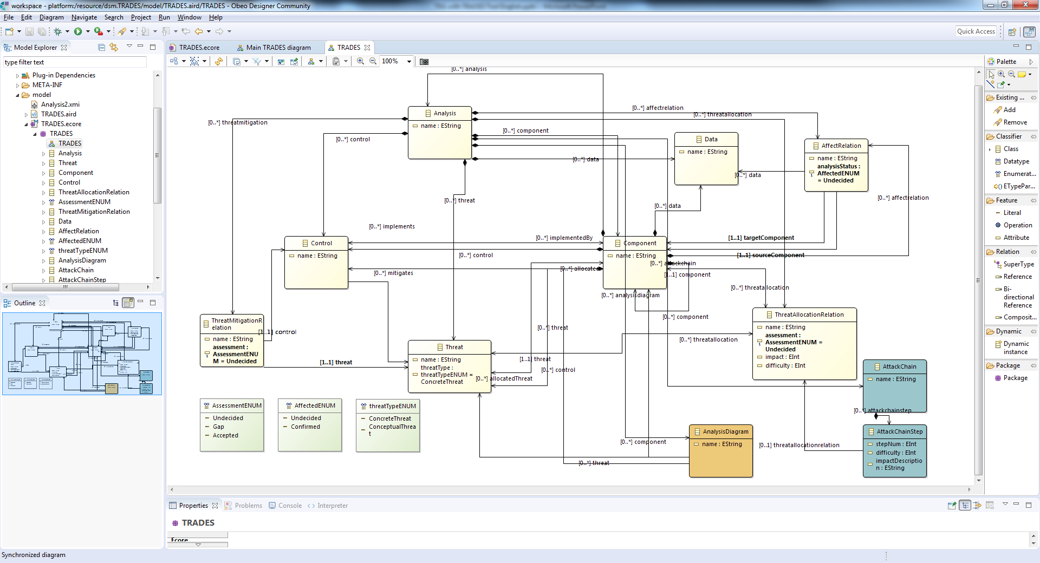
ECORE Metamodel

Slide 4
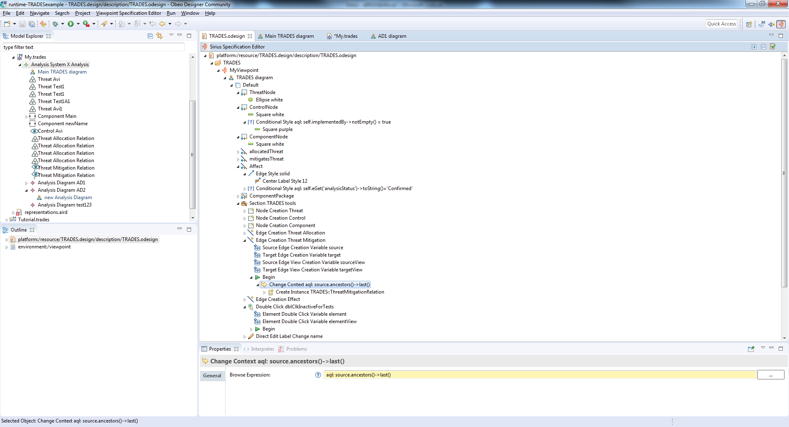
SIRIUS design

Slide 5
Demonstration
System cybersecurity analysis using TRADES Tool

Slide 6
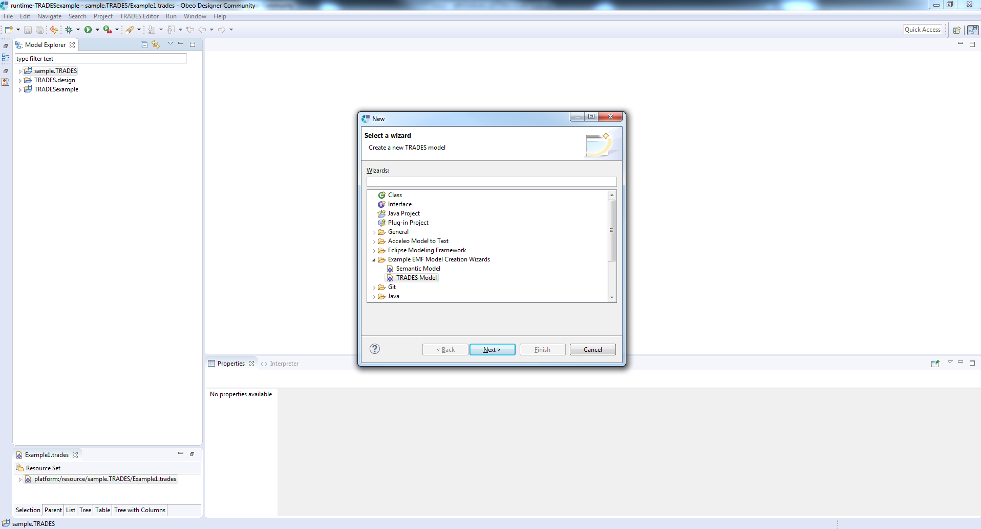
Create a new analysis project (TRADES Model)

Slide 7
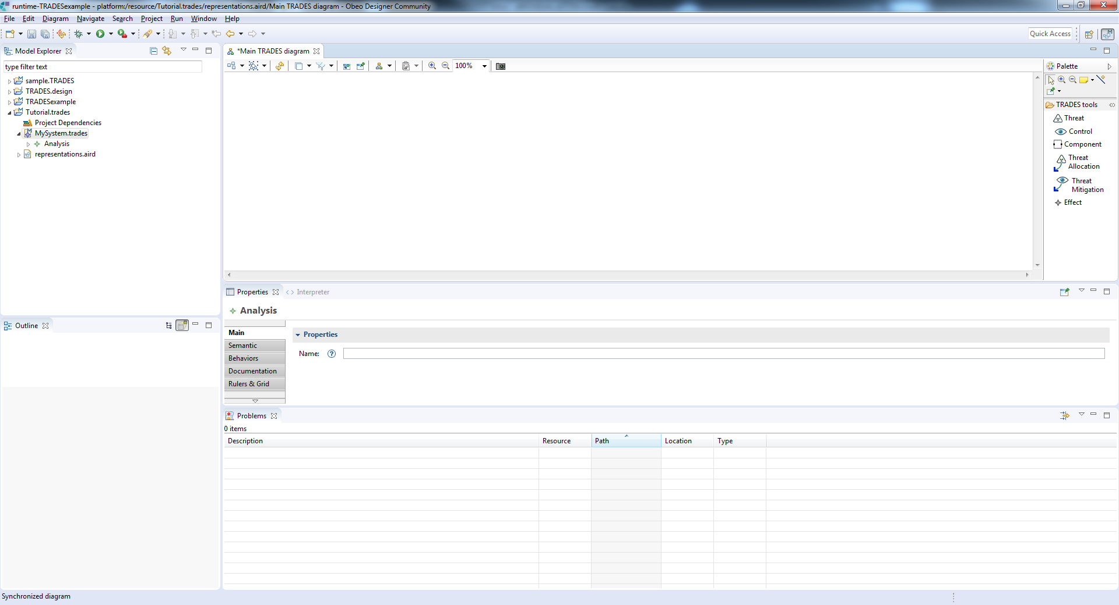
Navigation tree
Controls
Graphical modeling area
Model element properties

Slide 8
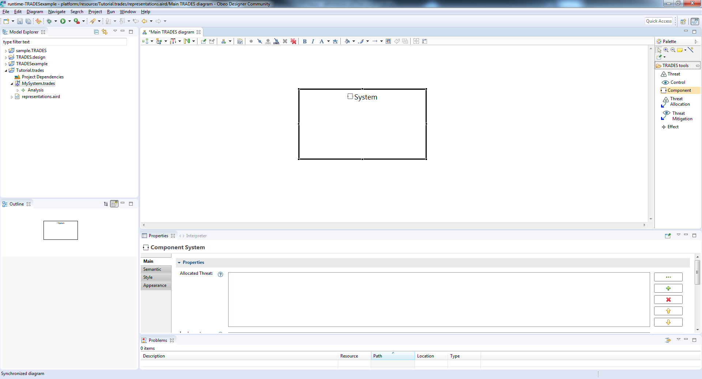
Use “component” to add a new physical/logical system component

Slide 9
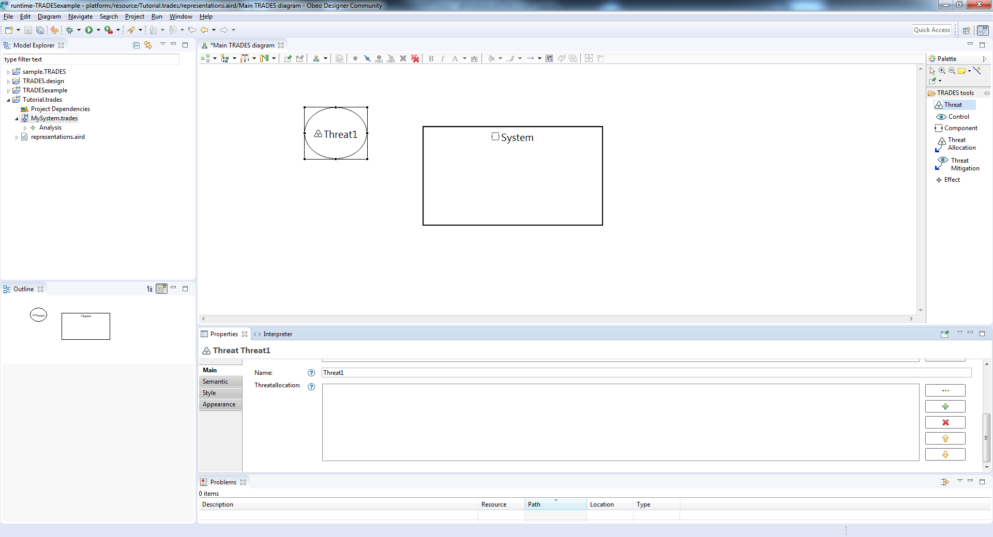
Use “Threat” to add a new threat

Slide 10
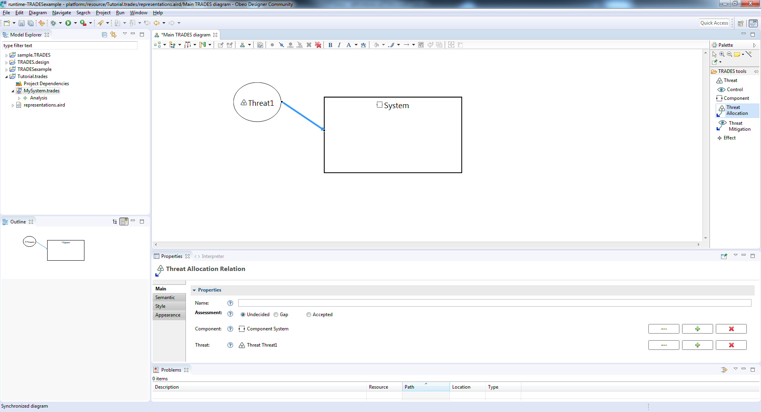
Use “Threat Allocation” to allocate a threat to a component

Slide 11
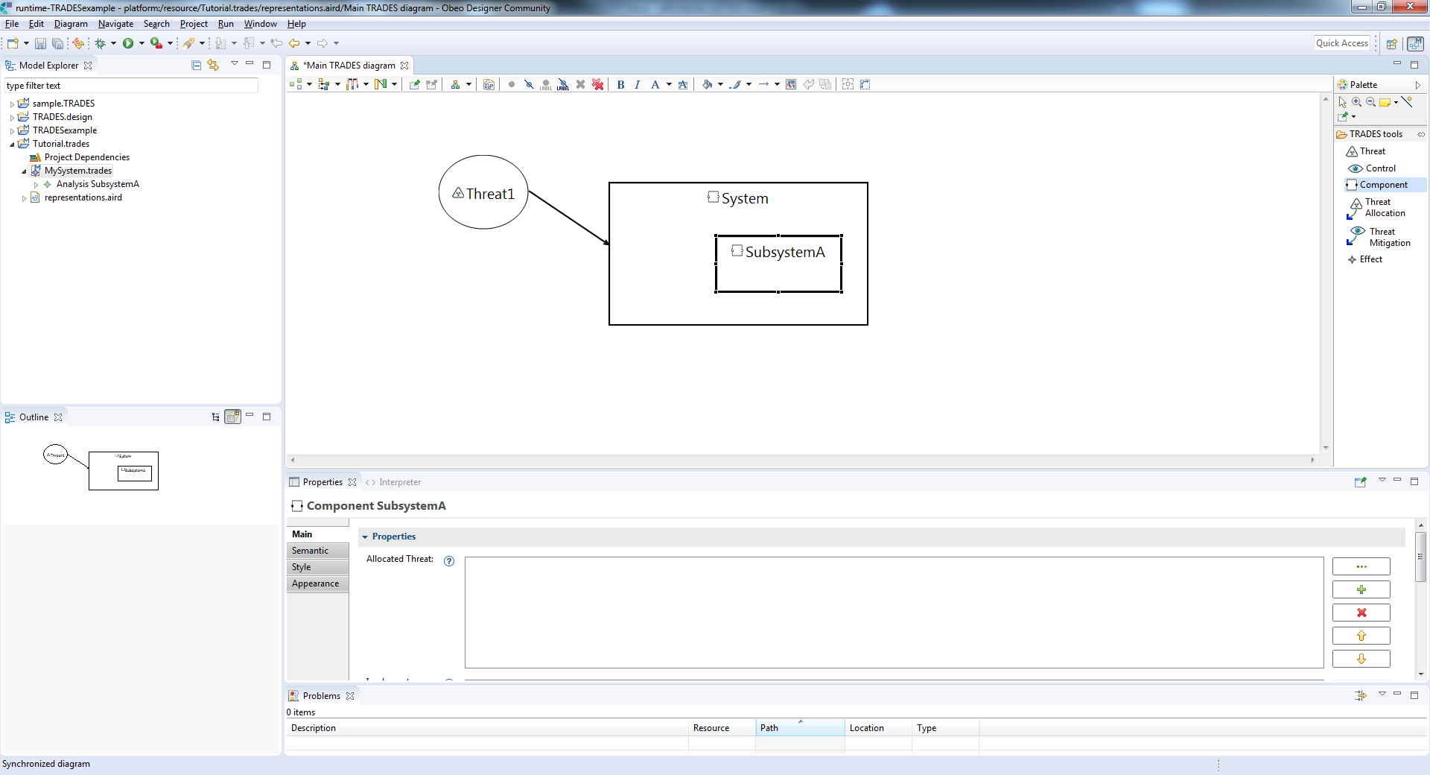
Create an additional component for a subsystem

Slide 12
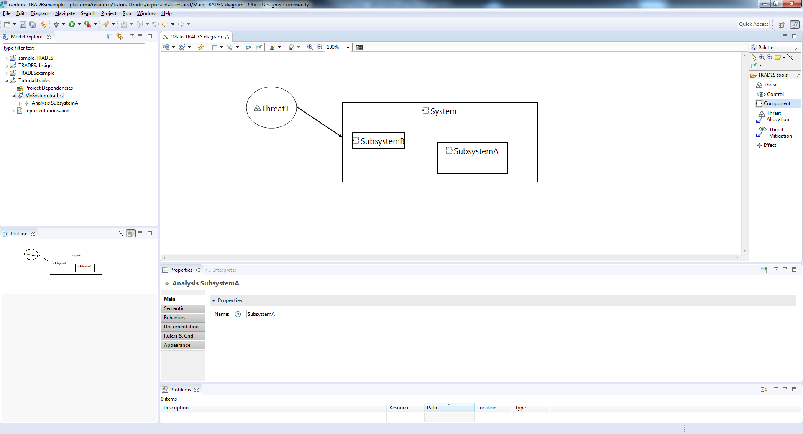
and another subsystem…

Slide 13
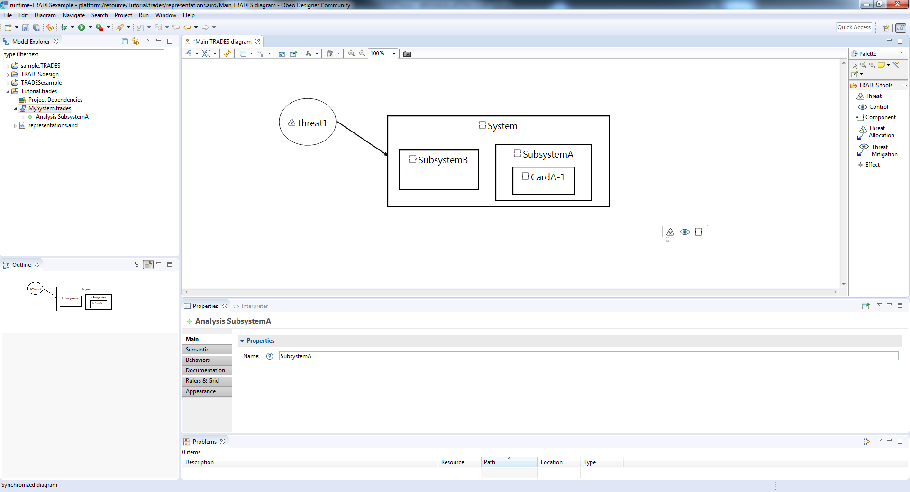
create a lower hierarchy component

Slide 14
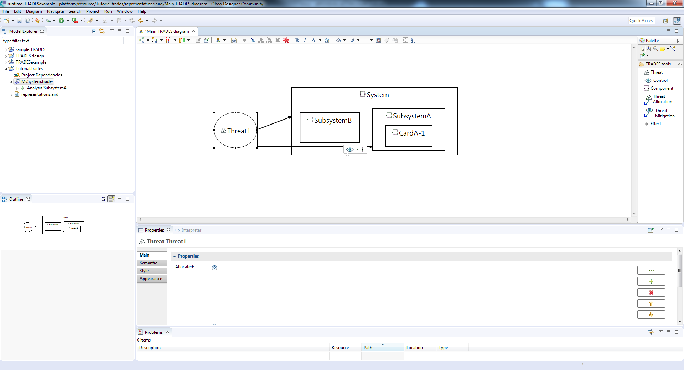
Allocate the threat to a subsystem

Slide 15
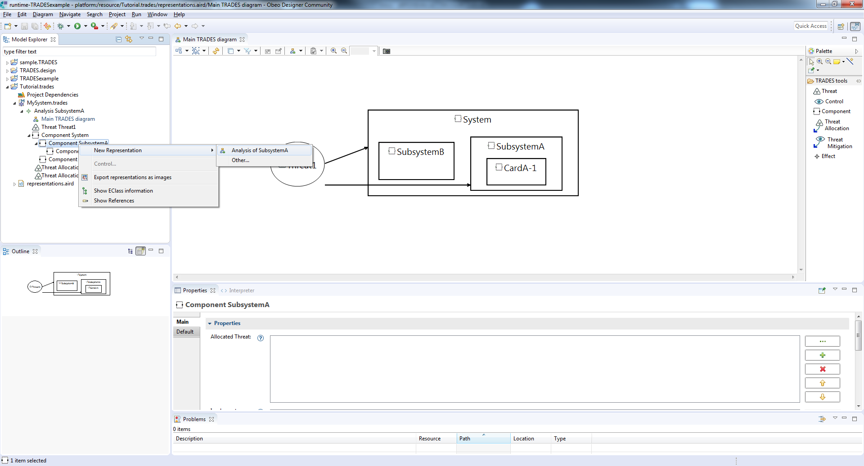
Open a new perspective for a dedicated analysis of the subsystem

Slide 16
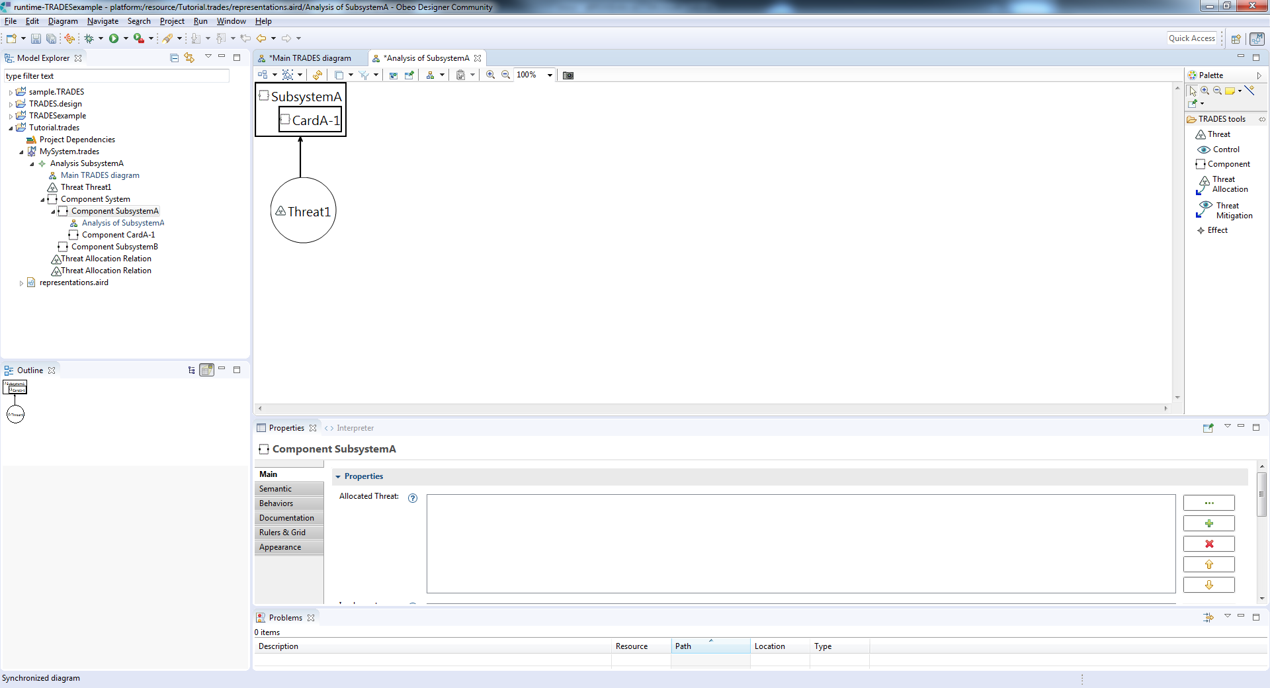
The new perspective is automatically synced with existing elements

Slide 17
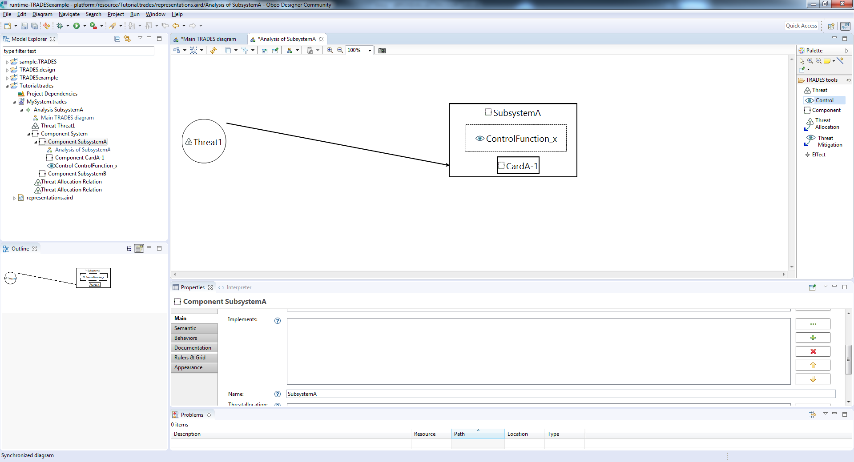
Add a security control using “Control”

Slide 18
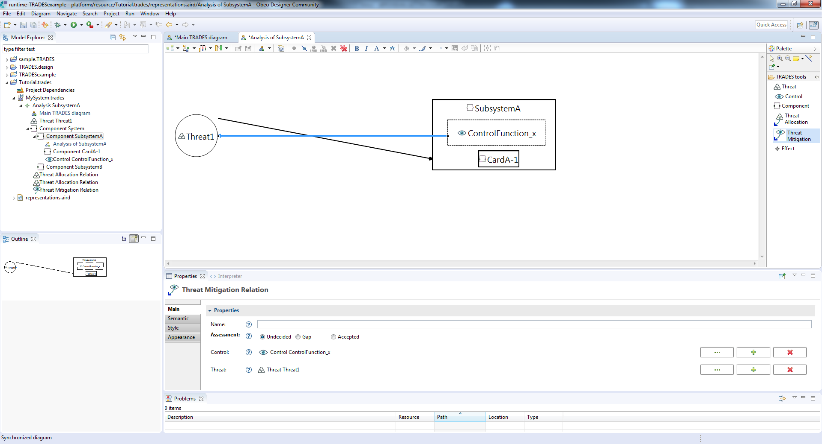
Associate the control with a threat using “Threat Mitigation”, to indicate the control mitigates the threat

Slide 19
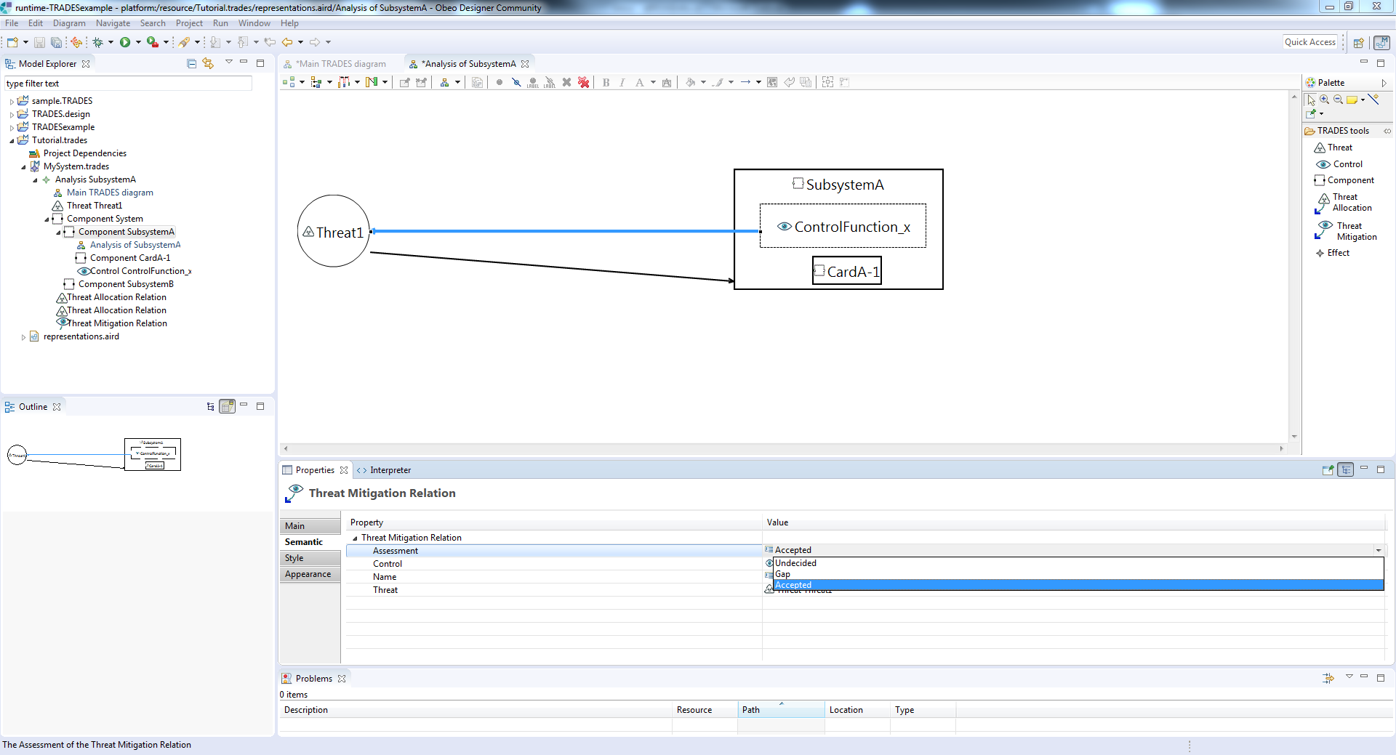
Decide if the threat mitigation is relevant

Slide 20
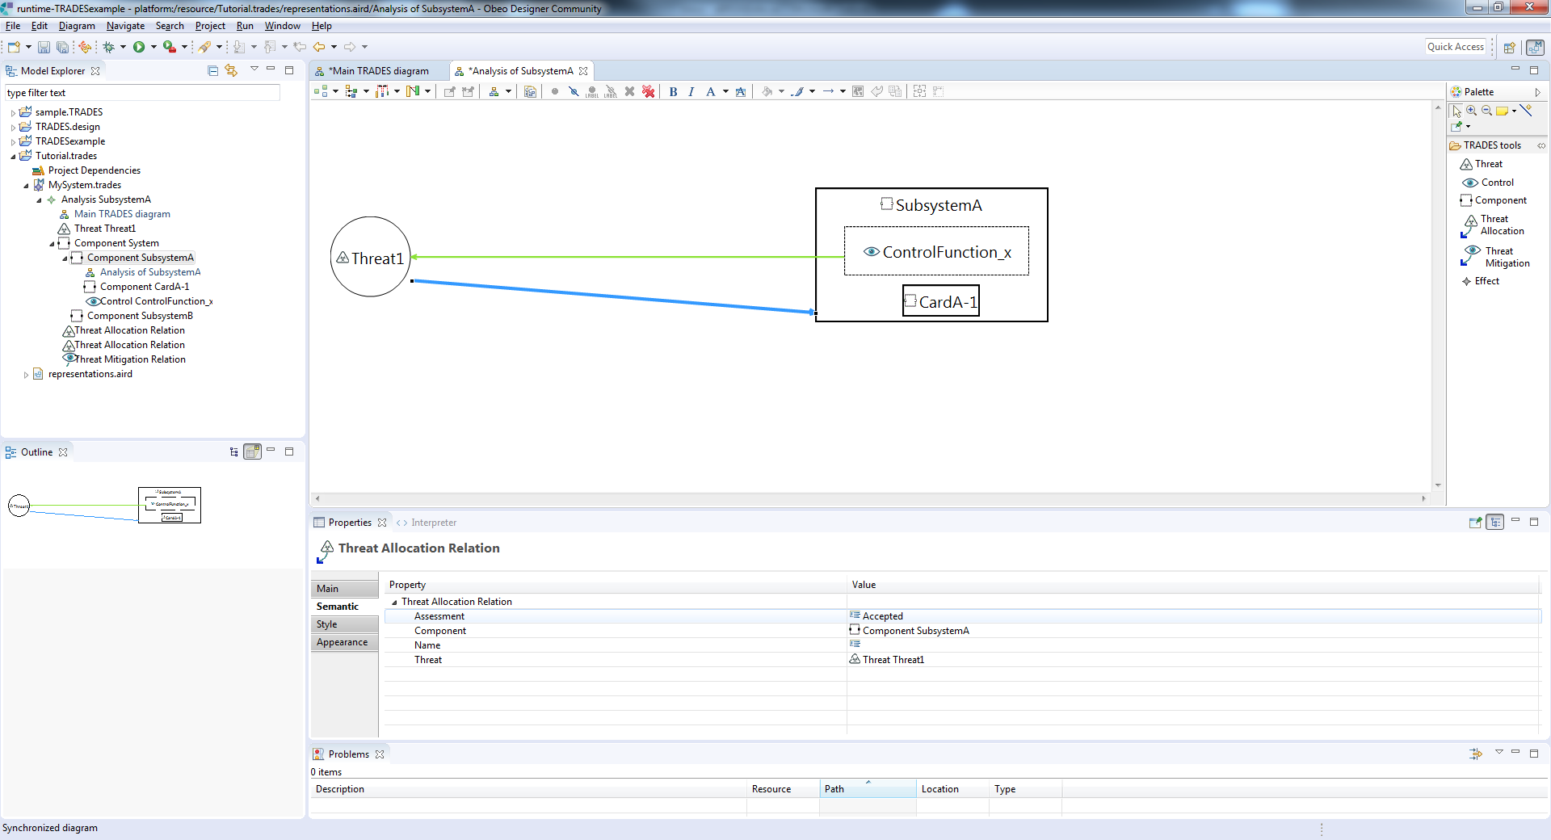
Link color changes according to decision

Slide 21
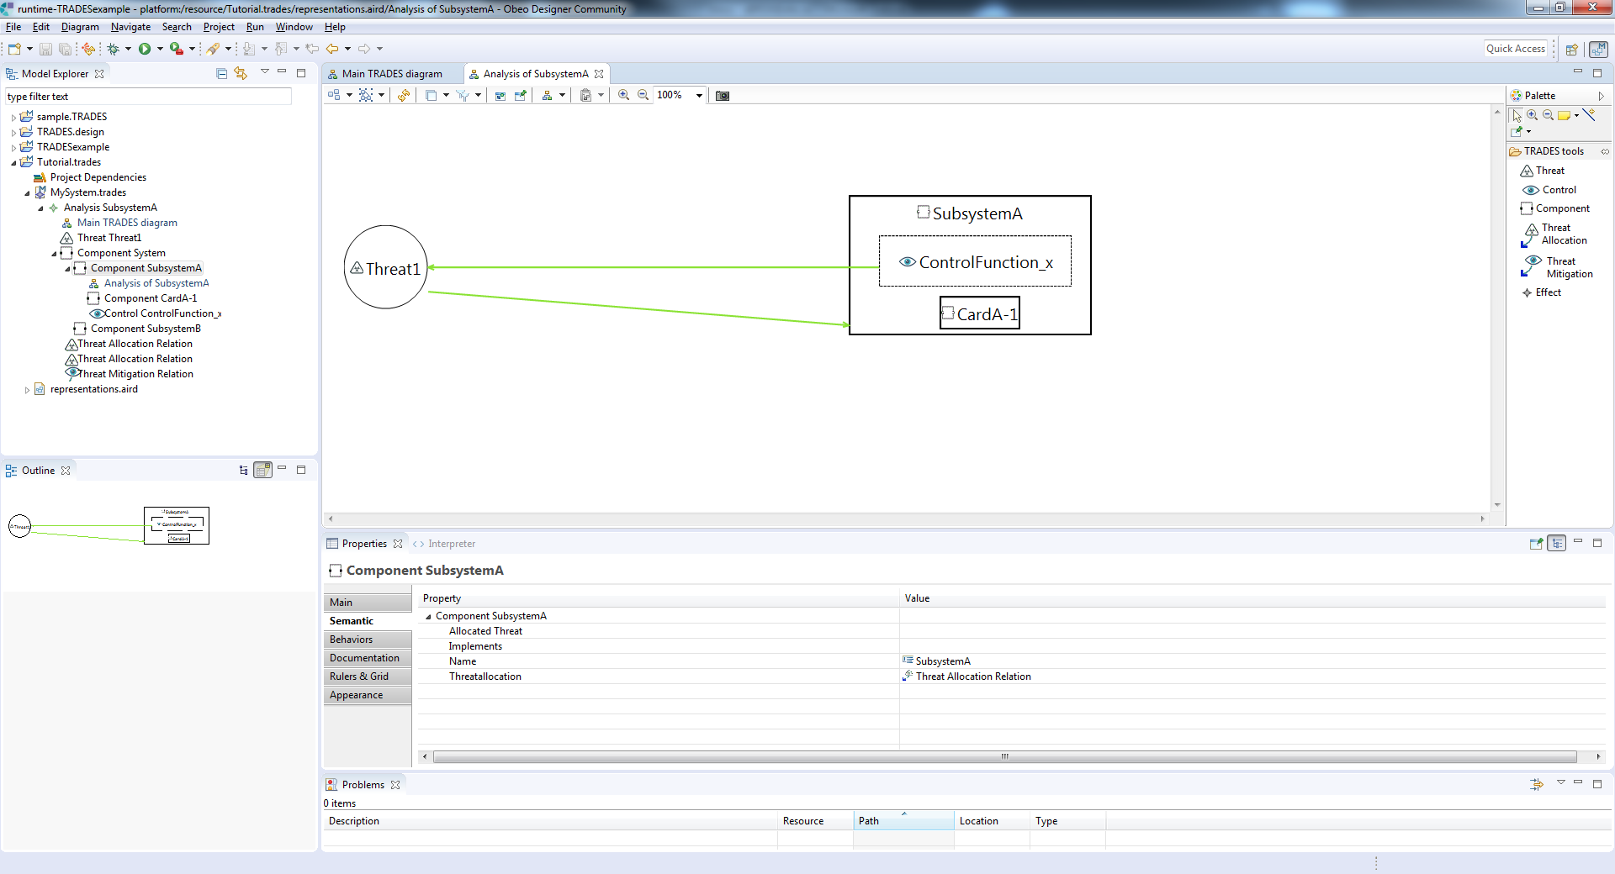
s
Threat allocation can now be assessed (a technical/managerial decision) and reflected in diagram

Slide 22
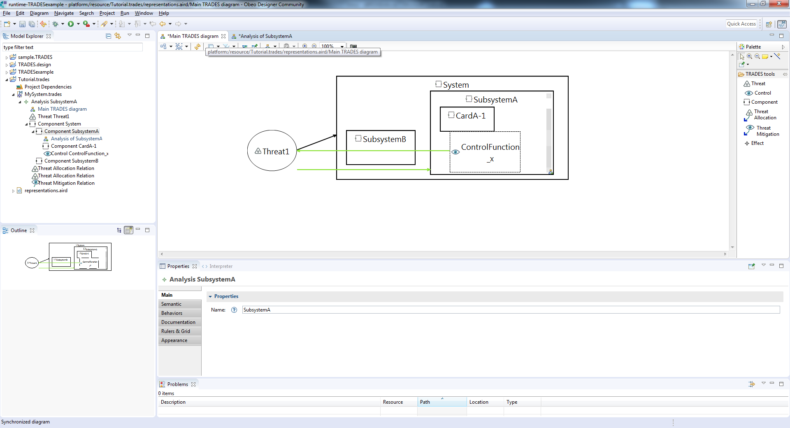
Main diagram is automatically synchronized with added elements and decisions

Slide 23
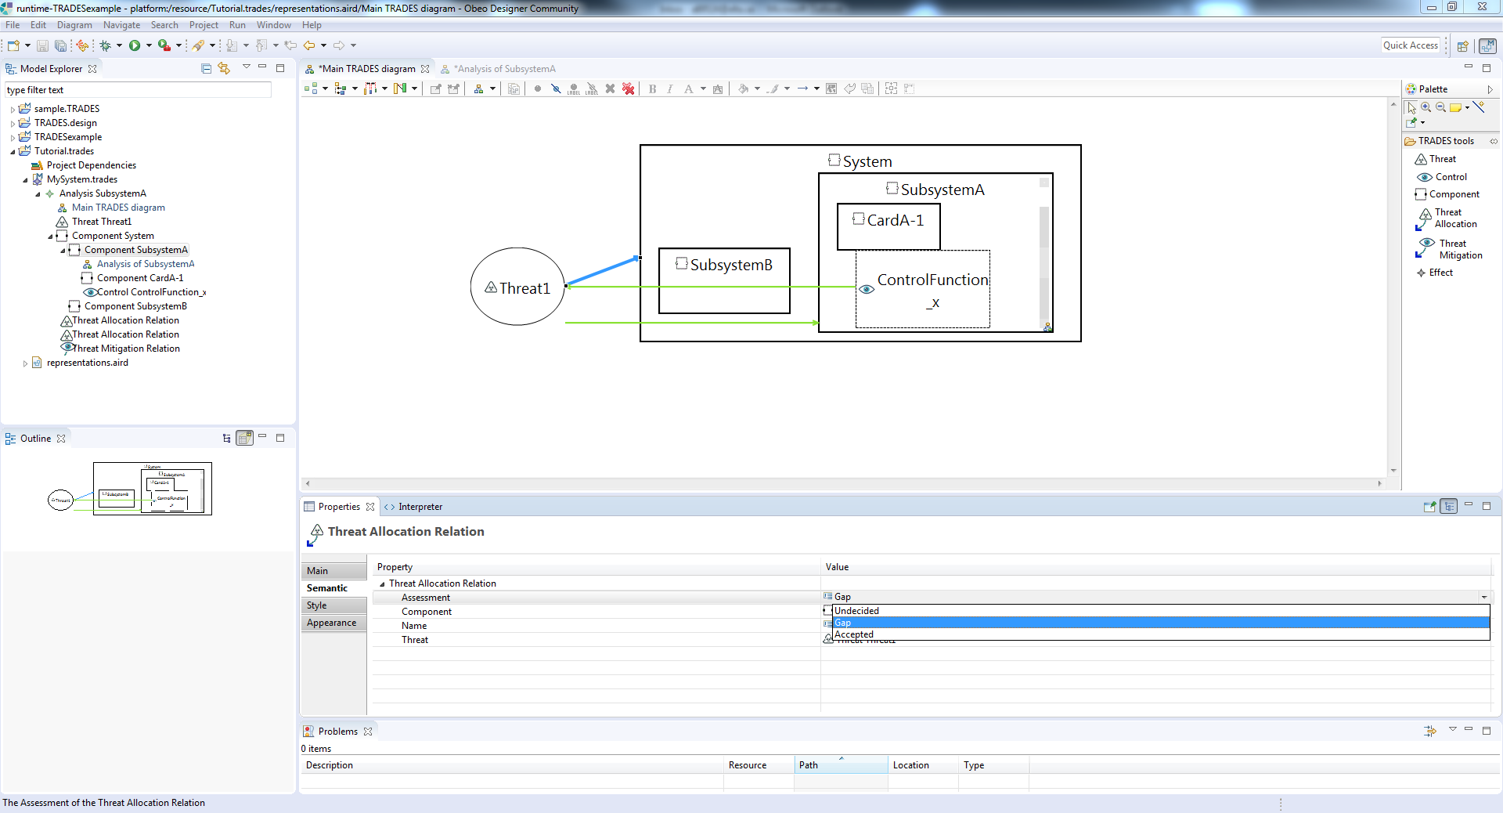
Threat allocation can be marked as a gap

Slide 24
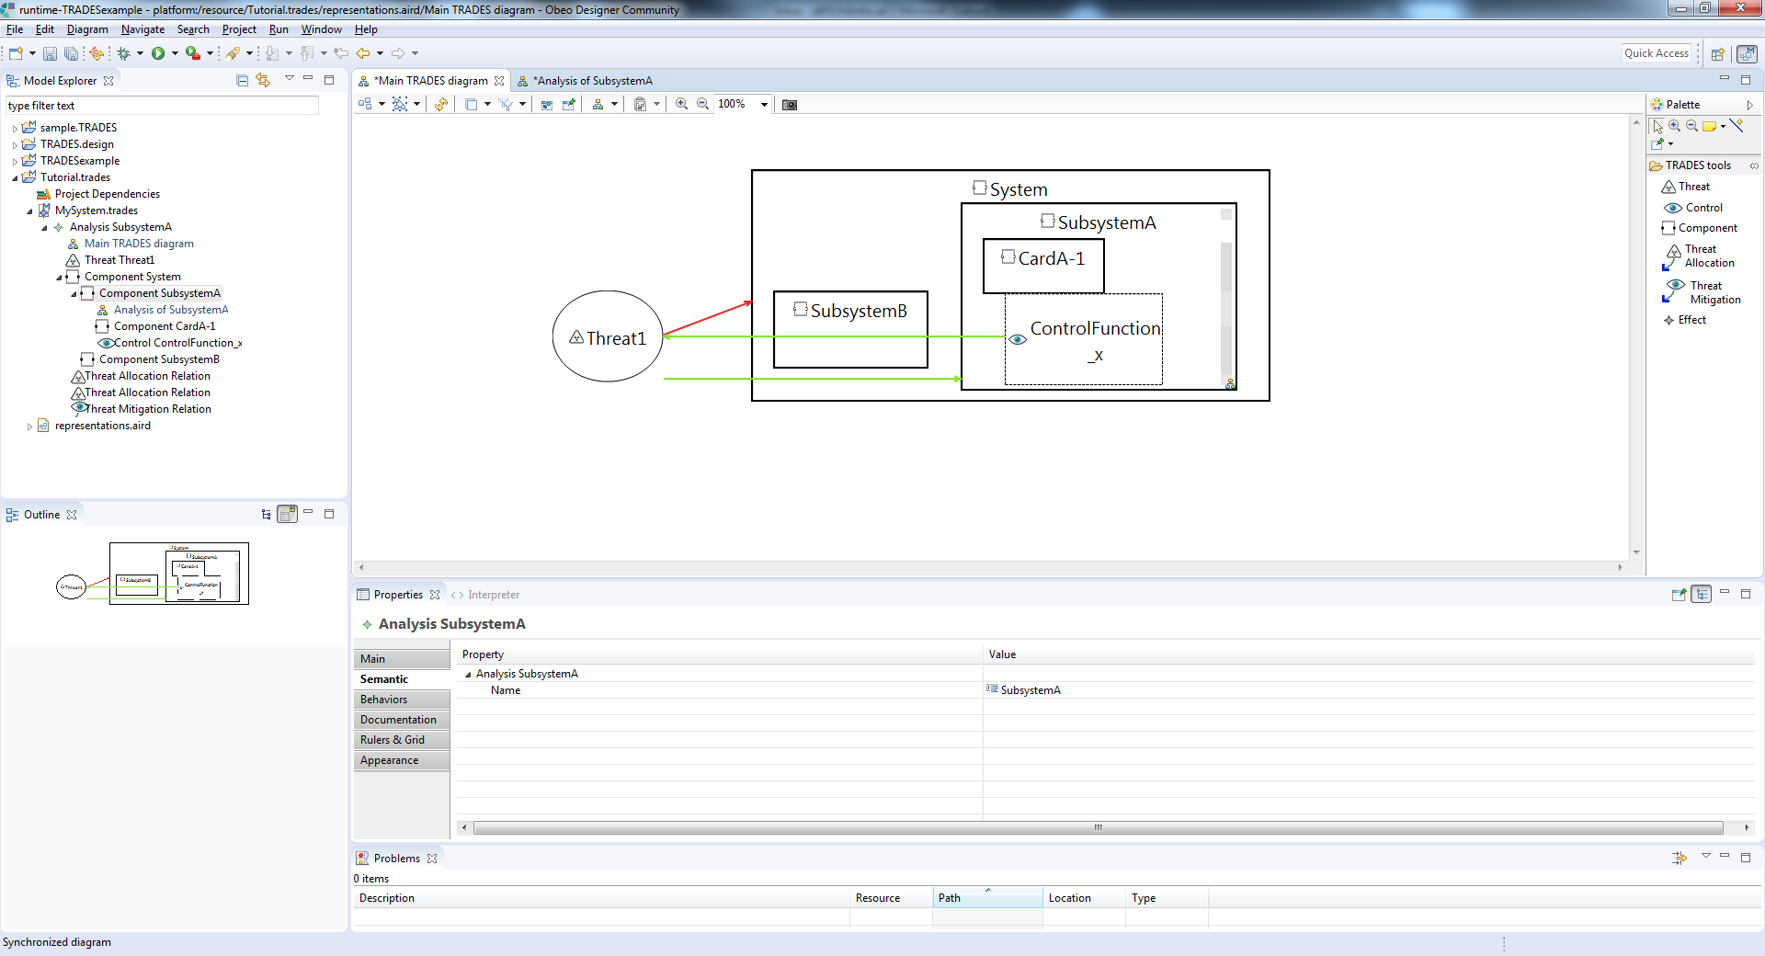
Threat allocation color is updated accordingly

Slide 25
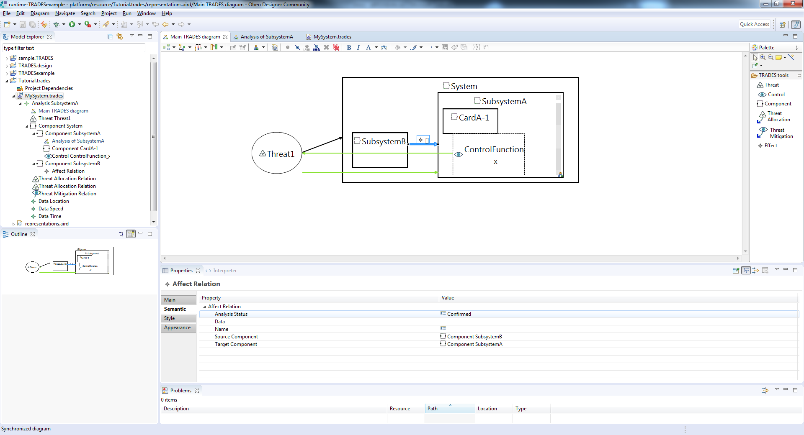
Data flow within the system can be added by using “Effect” between components

Slide 26
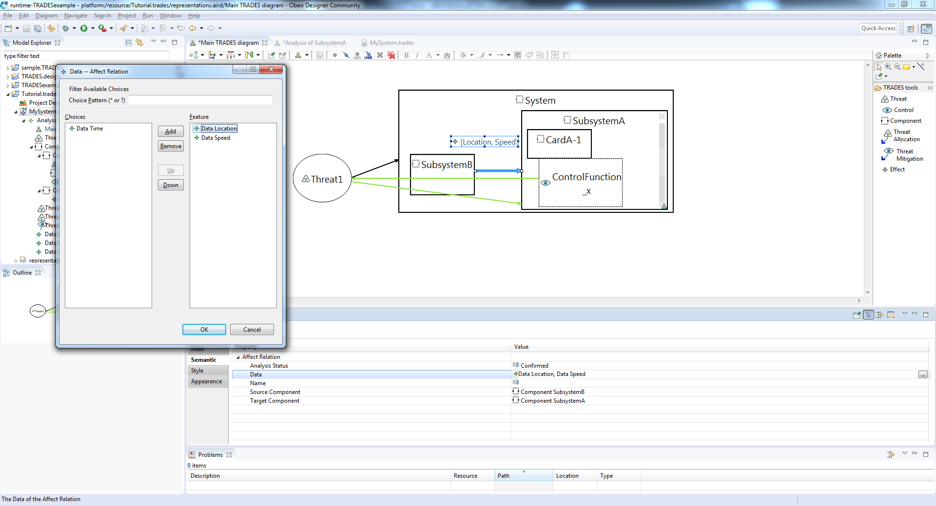
Existing or new data elements can be associated with the flow

Slide 27
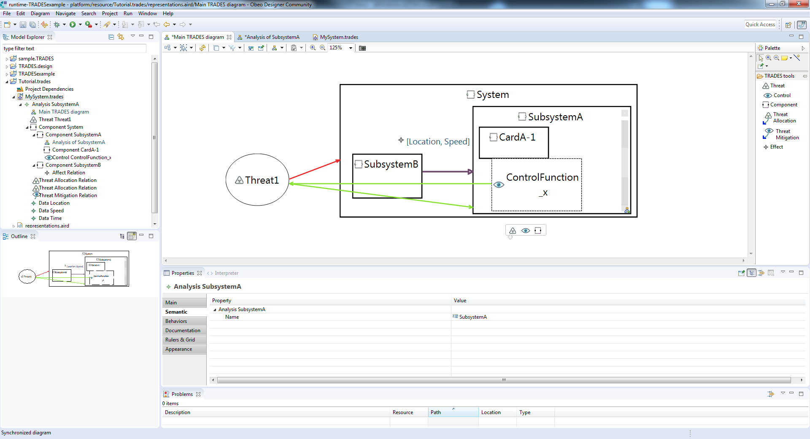

Slide 28
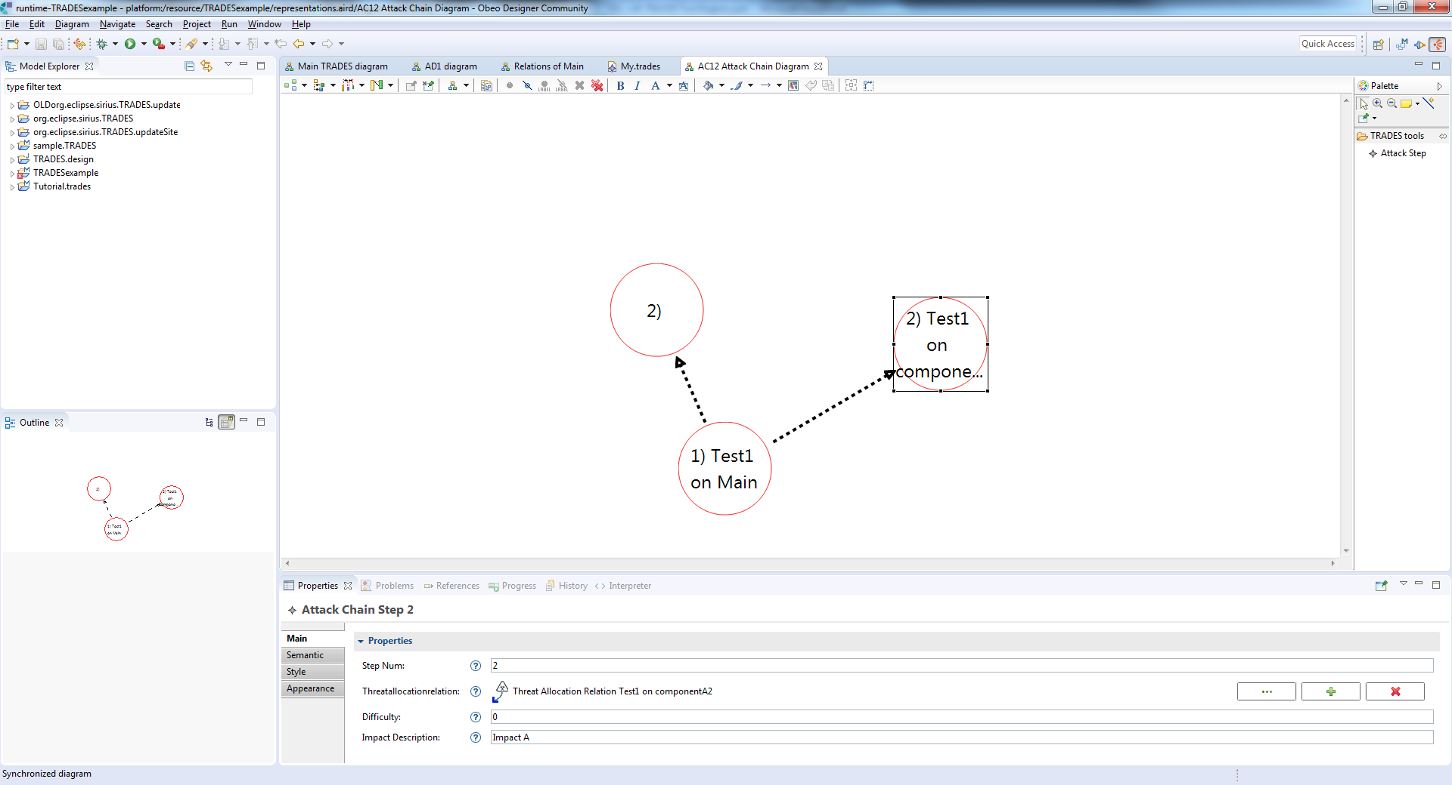
Create chains using existing entities

Slide 29
Summary
Elta’s Cyber Division developed a state of the art methodology and tool for cybersecurity related Threat and Risk assessment
TRADES model based approach enables design of complex systems in a coordinated and documented manner
TRADES domain specific modeling approach facilitates easy and efficient adoption
TRADES supports establishing and maintaining cybersecurity aspects of the design throughout the development and operational product lifecycle

